Slide 1
EasySearch
A Travel Based tool
Made for people with disabilities

Slide 2

Core Values
Accessibility
Innovation
Continuous Improvement
Empowerment

Slide 3
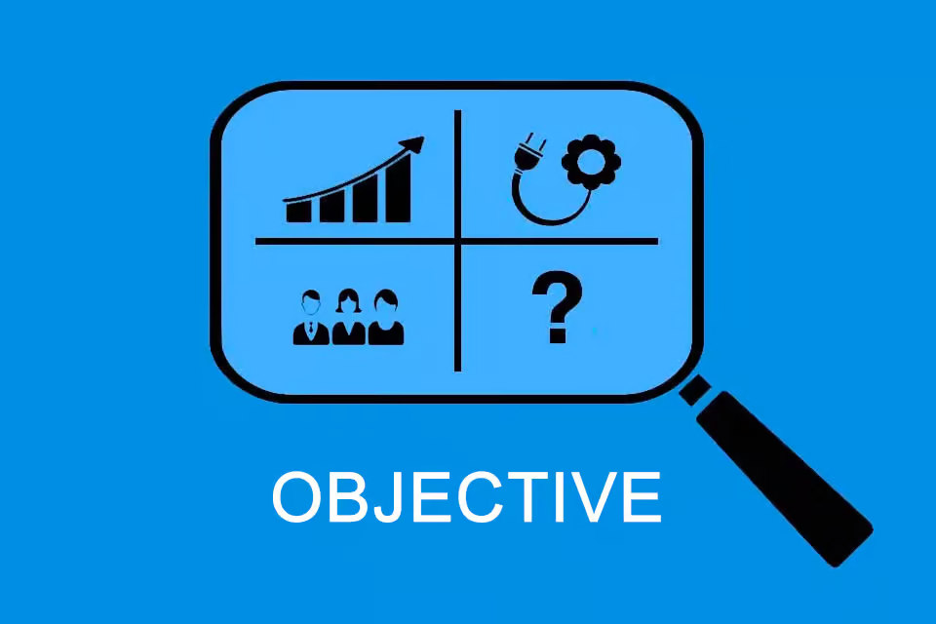
Objectives
Create a full stack travel-assistant application.
Tailor the application to the needs of disabled travelers.
Develop an accurate speech-to-text feature that can effectively convert spoken words into written text.
Develop a personalized chatbot that can give accurate recommendation and advices based on traveler’s location and preferences
Incorporate responsive user-friendly interfaces and accessibility features
Conduct extensive testing and user feedback sessions to ensure the best application for our user

Slide 4
Target Audience
Visually Impaired Travelers
Travelers with Disabilities
Travelers
Perspective Travelers
People who seek a resource to find traveling tips

Slide 5
Competitive Advantage
Tailored for the visually impaired travelers: The application is was designed to enhance the travel experience for individuals with visual impairments, giving it a niche focus and competitive edge.
User centered design allows us to understand preferences of our user and design accordingly.
Innovative features such as generative AI, personalization, and Text-to-Speech are not typically included in other travel application.

Slide 6
Key Features & Future Enhancements
Integration of travel blog
Integration of collaboration mechanism
Integration of ranking system
Refinement of Chatbot
Refinement of personalization features

Slide 7
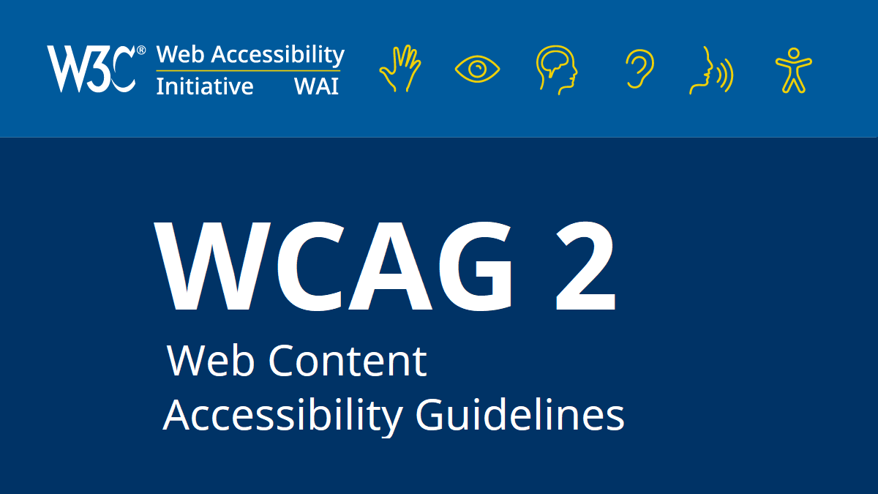
Accessibility Guidelines
Web Content Accessibility Guidelines (WCAG)
Understanding WCAG
Key Concepts and Principles of WCAG

Slide 8
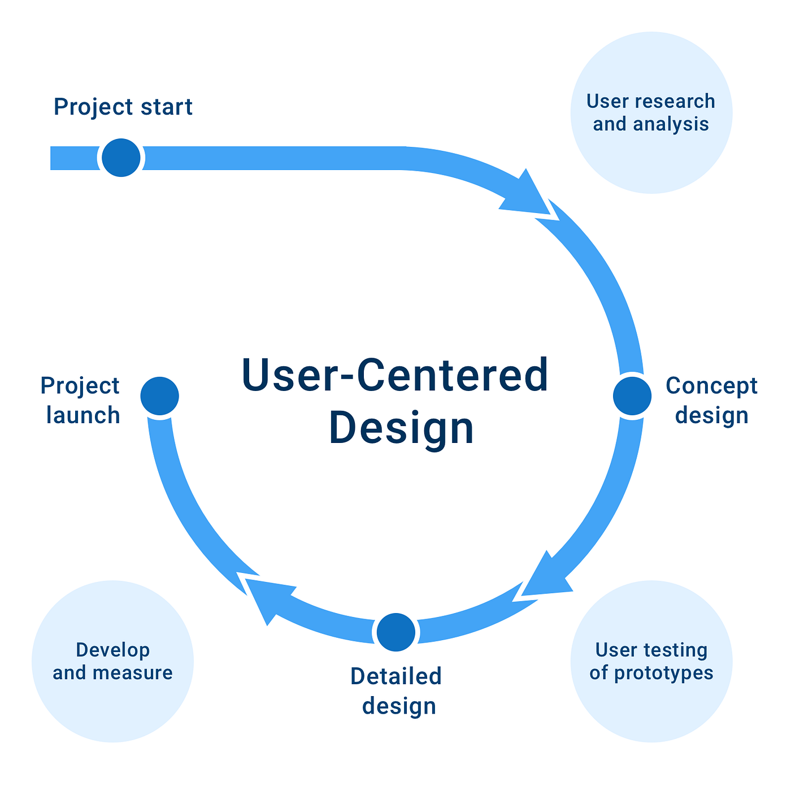
UI Design Approach
User-centered design: Design phases will prioritize the user input, considering their opinions throughout the development process.
User Personas will be created based on our user base.
Surveys, interviews, and Q&A will provide insights into user preferences and areas for improvement.
User Research will be conducted to understand user’s behavior and motivation.

Slide 9
Technology Stack
Development Languages
HTML & SCSS
Typescript
C#
SQL
Frameworks and Tools
Bootstrap 4
Angular 15
Dotnet Core 7
Identity Framework
SQL Server

Slide 10
Microservice Architecture Overview
Front-End
Chatbot Module
Account Module
Travel Blog Module
API Gateway
Entry Point for all Microservices API’s
Handle Authorization and Authentication between API’s via JWT token
Back-End
Chatbot System
Account System
Travel Blog System

Slide 11
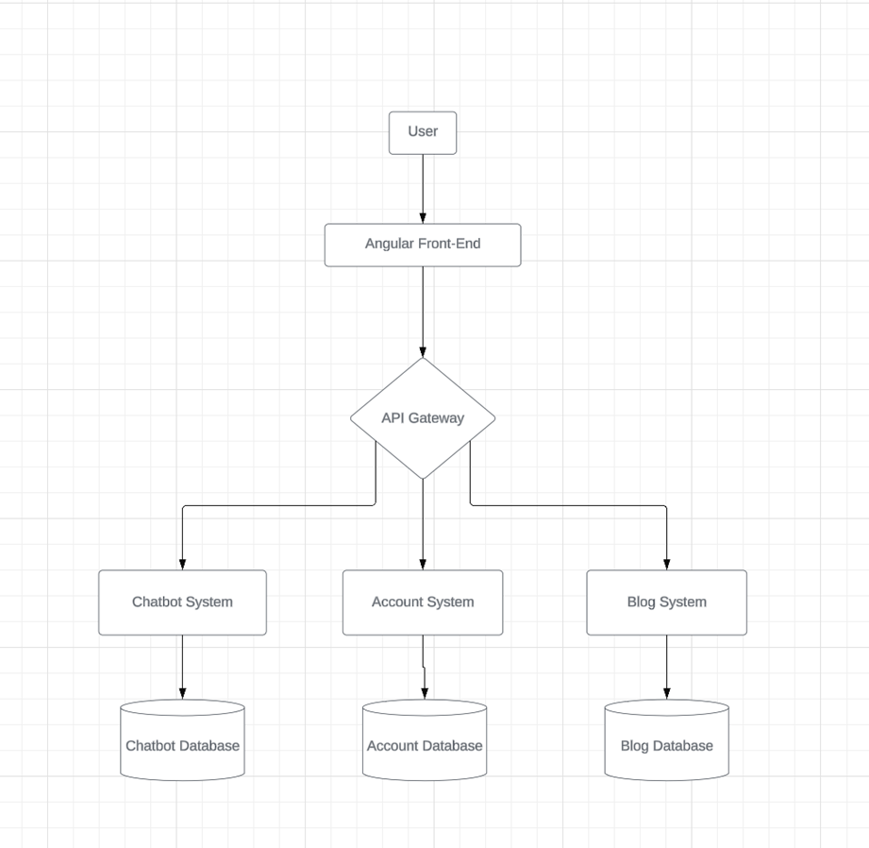

Slide 12
Front-End Design
Angular
Modularize design to encapsulate independent system logic
Services for data fetching and state management
RXJS: For handling events and asynchronous data stream
Bootstrap 4
User Interface library with prebuilt responsive components
SCSS
Styled sheet scripting language used to make custom variables and mixins to build reusable CSS library

Slide 13
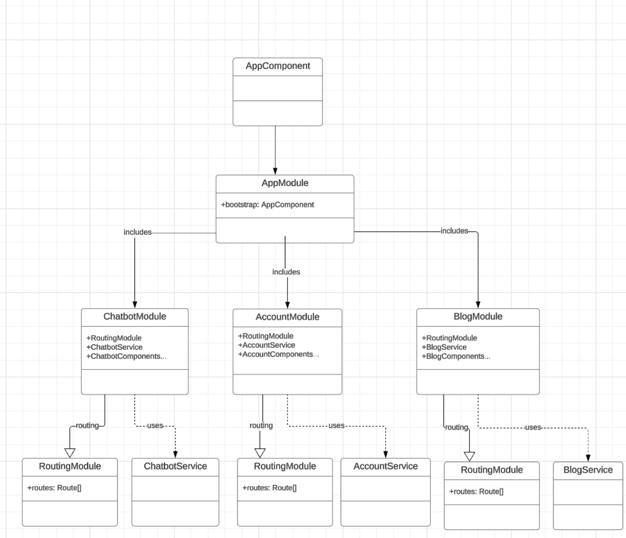

Slide 14
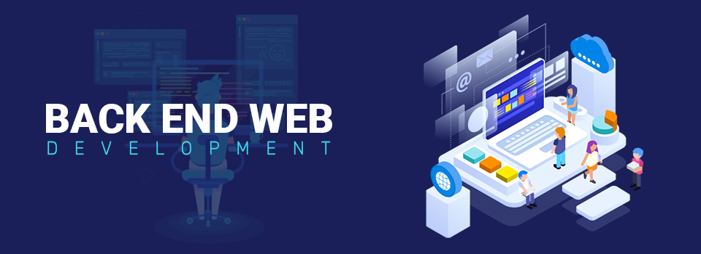
Back-End Design
Microservice Dotnet Web API
Repository Pattern & DTO
Specification Pattern
Identity Framework
SQL Server

Slide 15
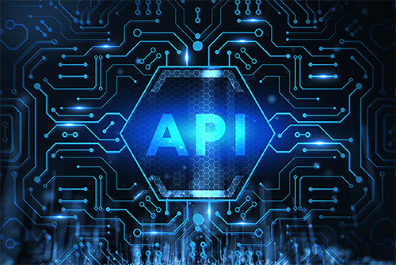
API Integration
ChatGpt API: Used to create custom chatbot for users.
Web Speech API: Used to convert spoken speech to text.
Account API: Used to create, authenticate, and authorize users across microservices

Slide 16
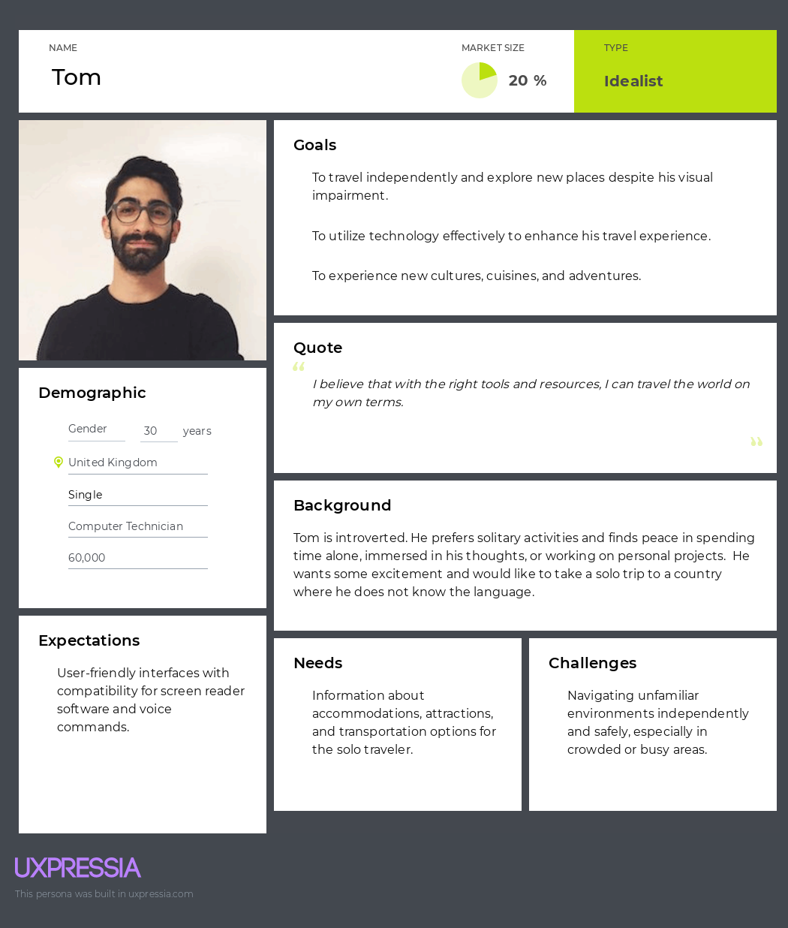
Persona - Tom

Slide 17
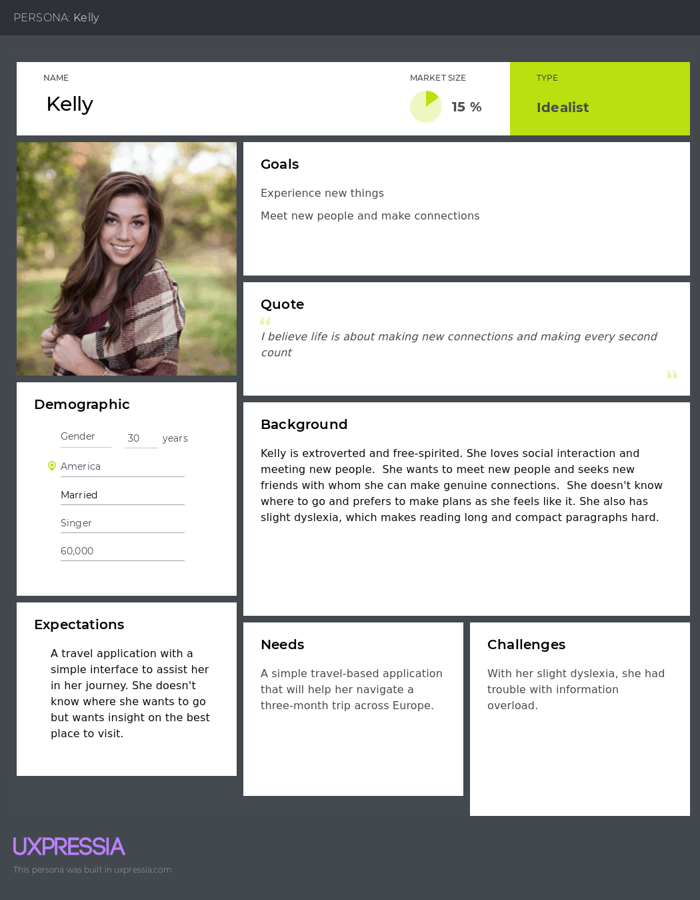
Persona - Kelly

Slide 18
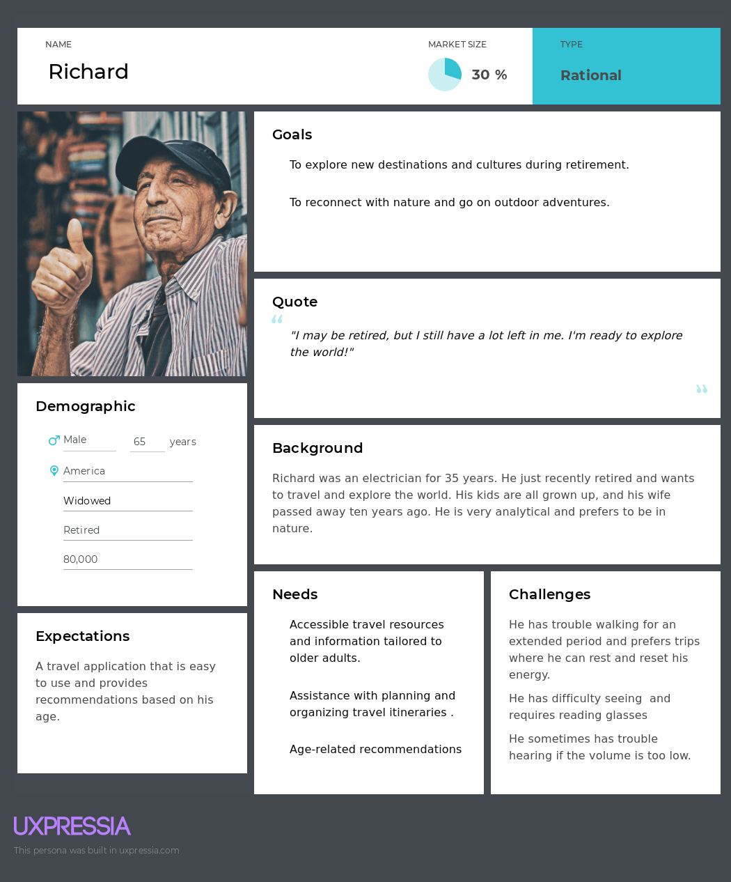
Persona - Richard

Slide 19
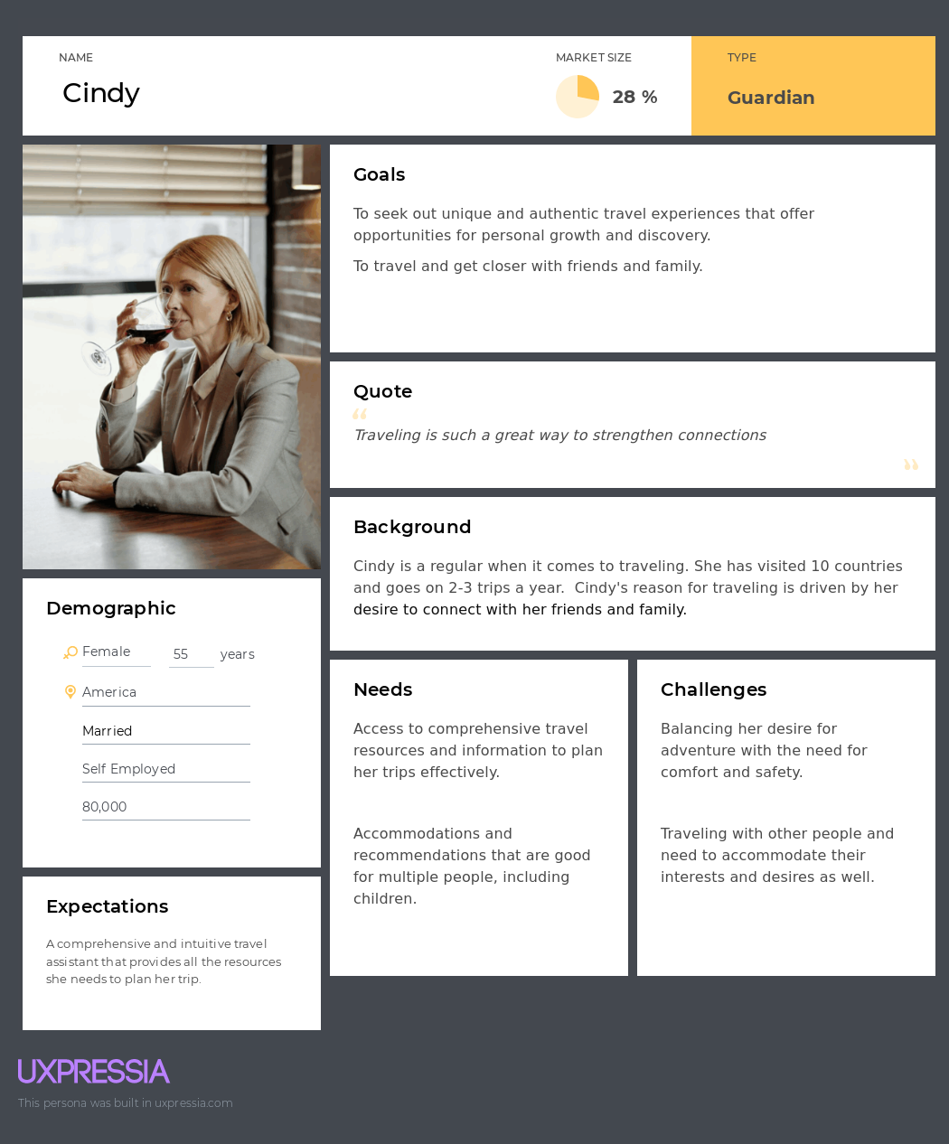
Persona - Cindy

Slide 20
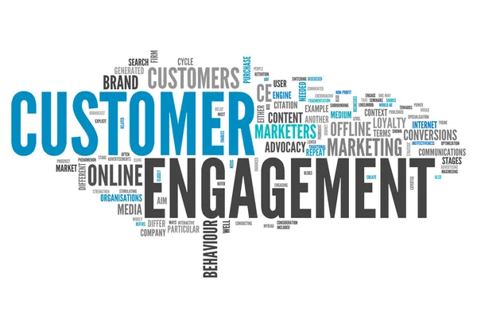
Marketing & Engagement Strategies
Audience Research
Determining & Measuring KPIs
SEO Optimization Strategy
Gamification Plan
Surveys and Polls
Content Marketing
Email Marketing
Community Engagement

Slide 21
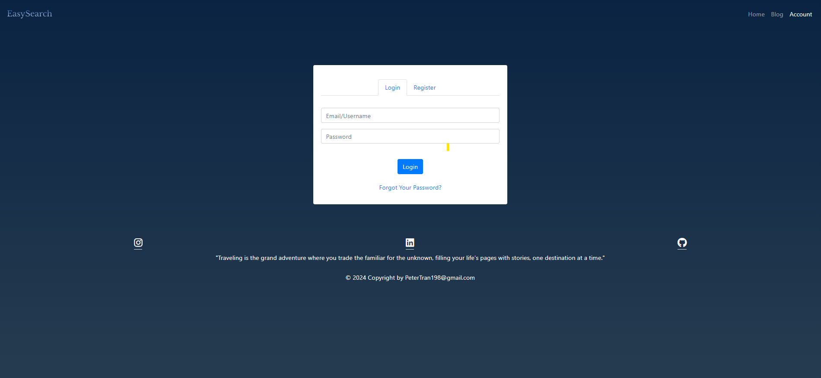
Minimum Viable Product - Login

Slide 22
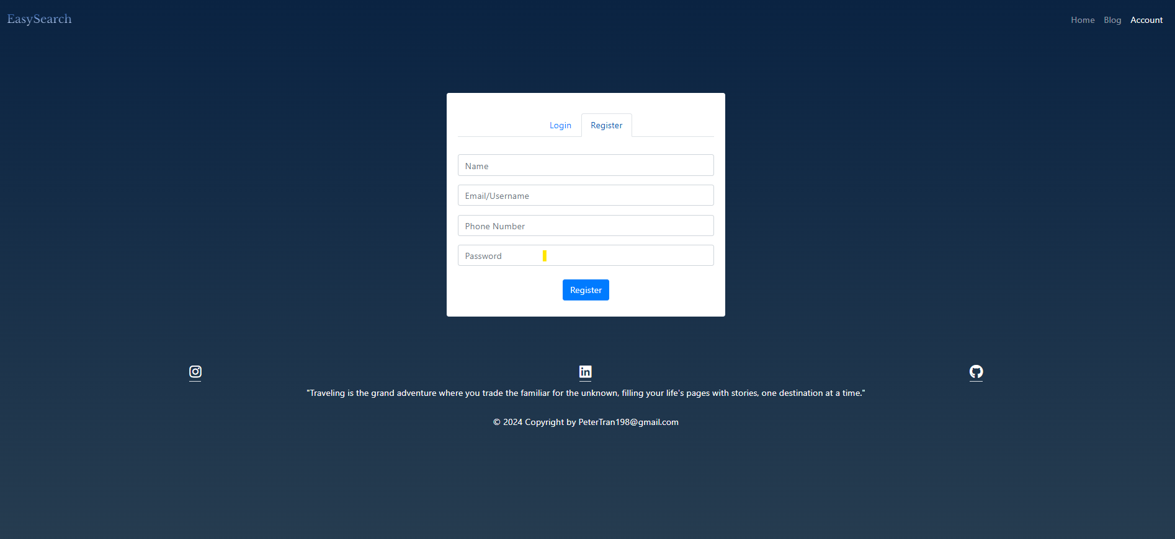
Minimum Viable Product - Register

Slide 23
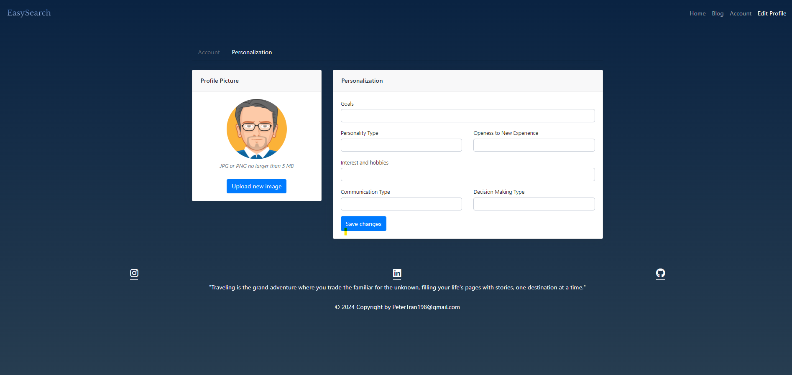
Minimum Viable Product – Personalization Tab for AI and Blog

Slide 24
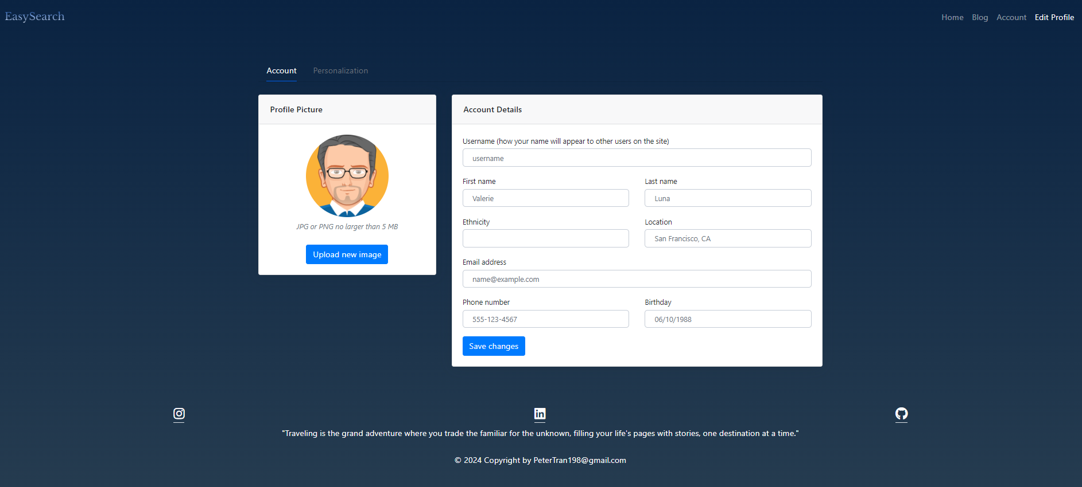
Minimum Viable Product – Profile

Slide 25
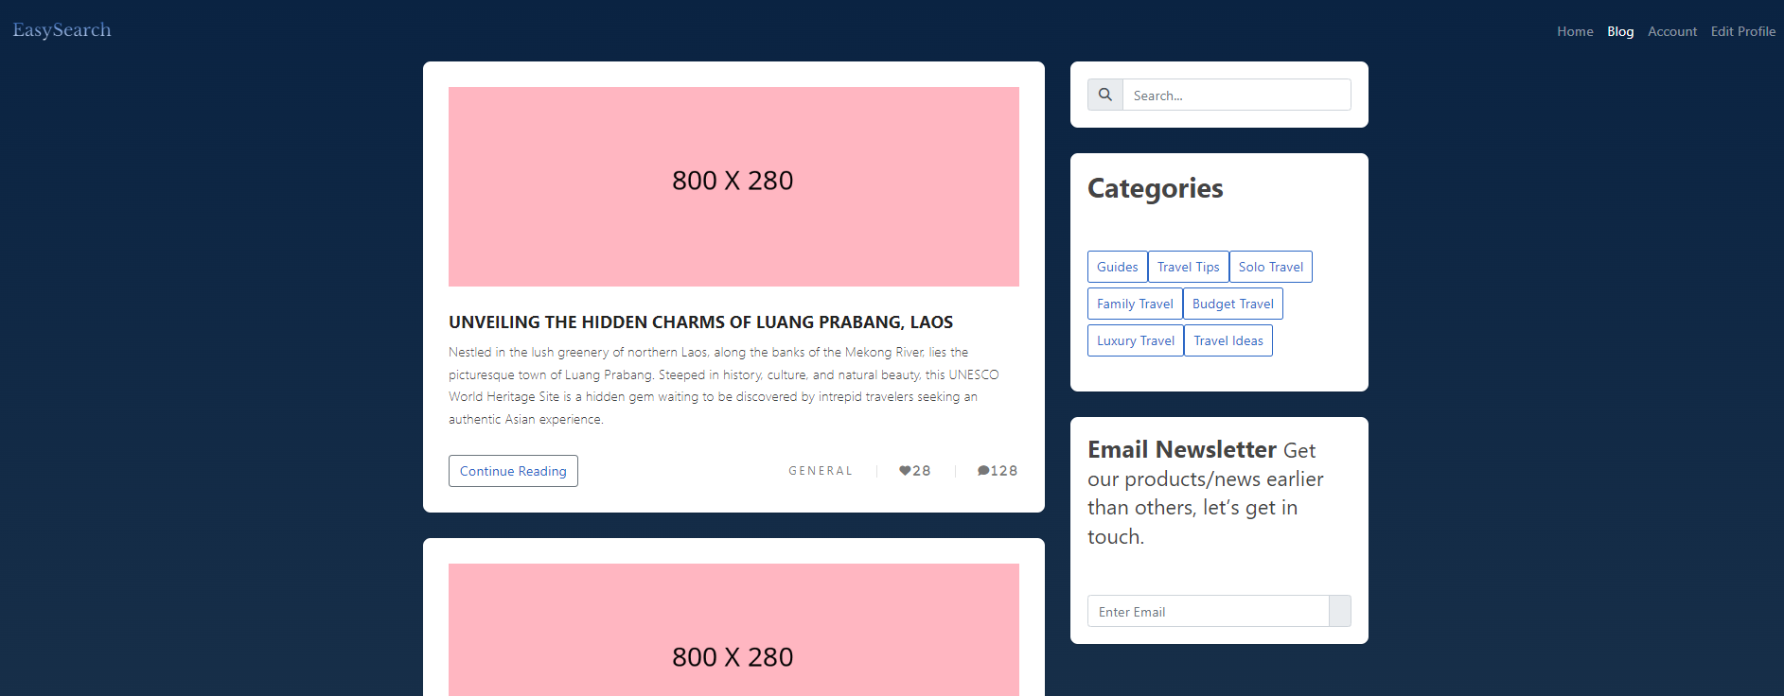
Minimum Viable Product – Blog - 1

Slide 26
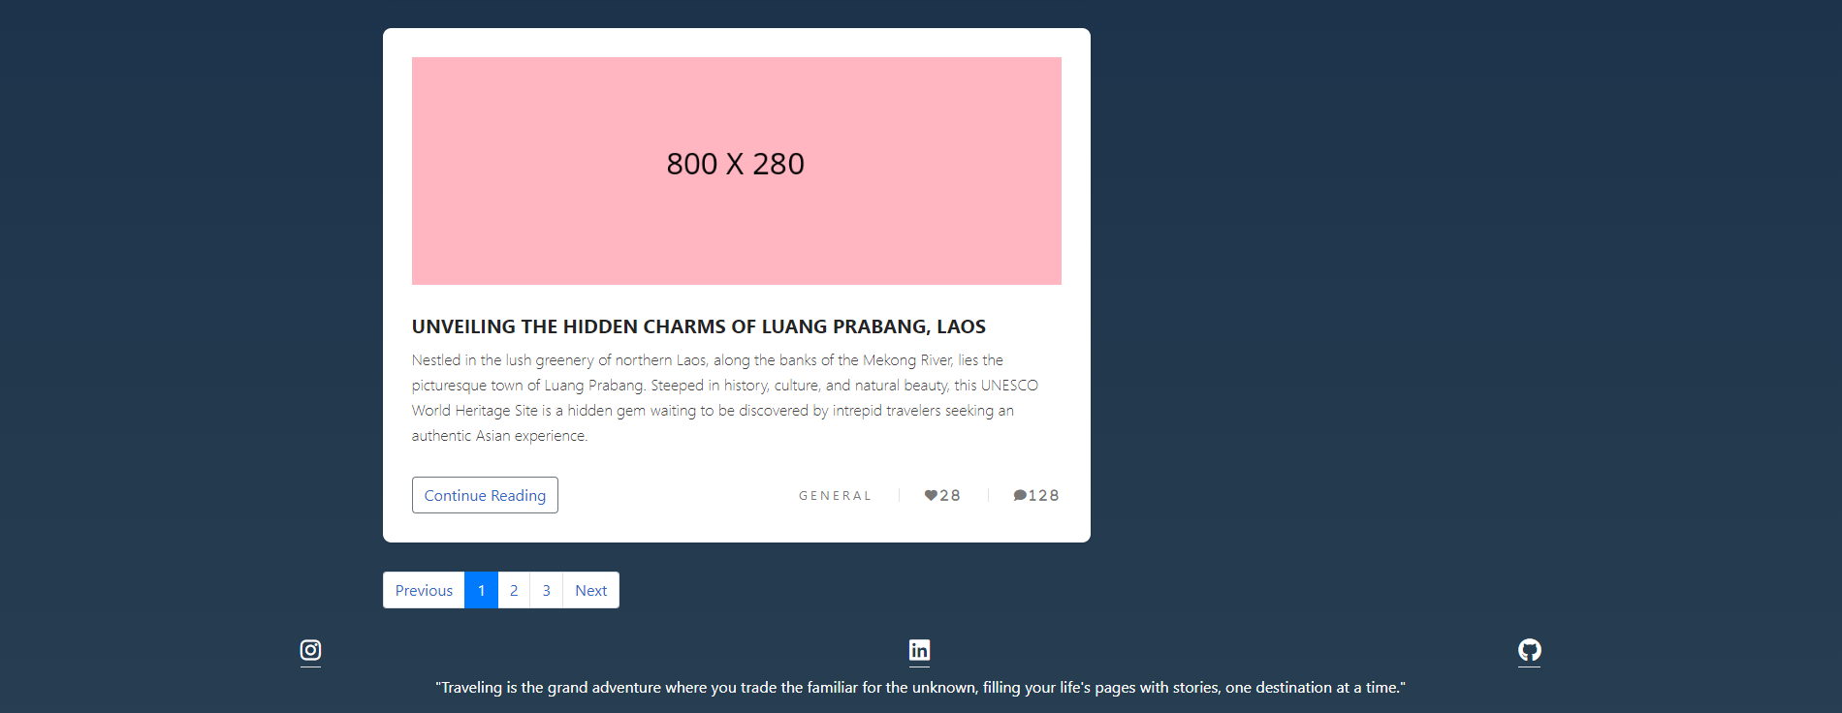
Minimum Viable Product – Blog - 2

Slide 27
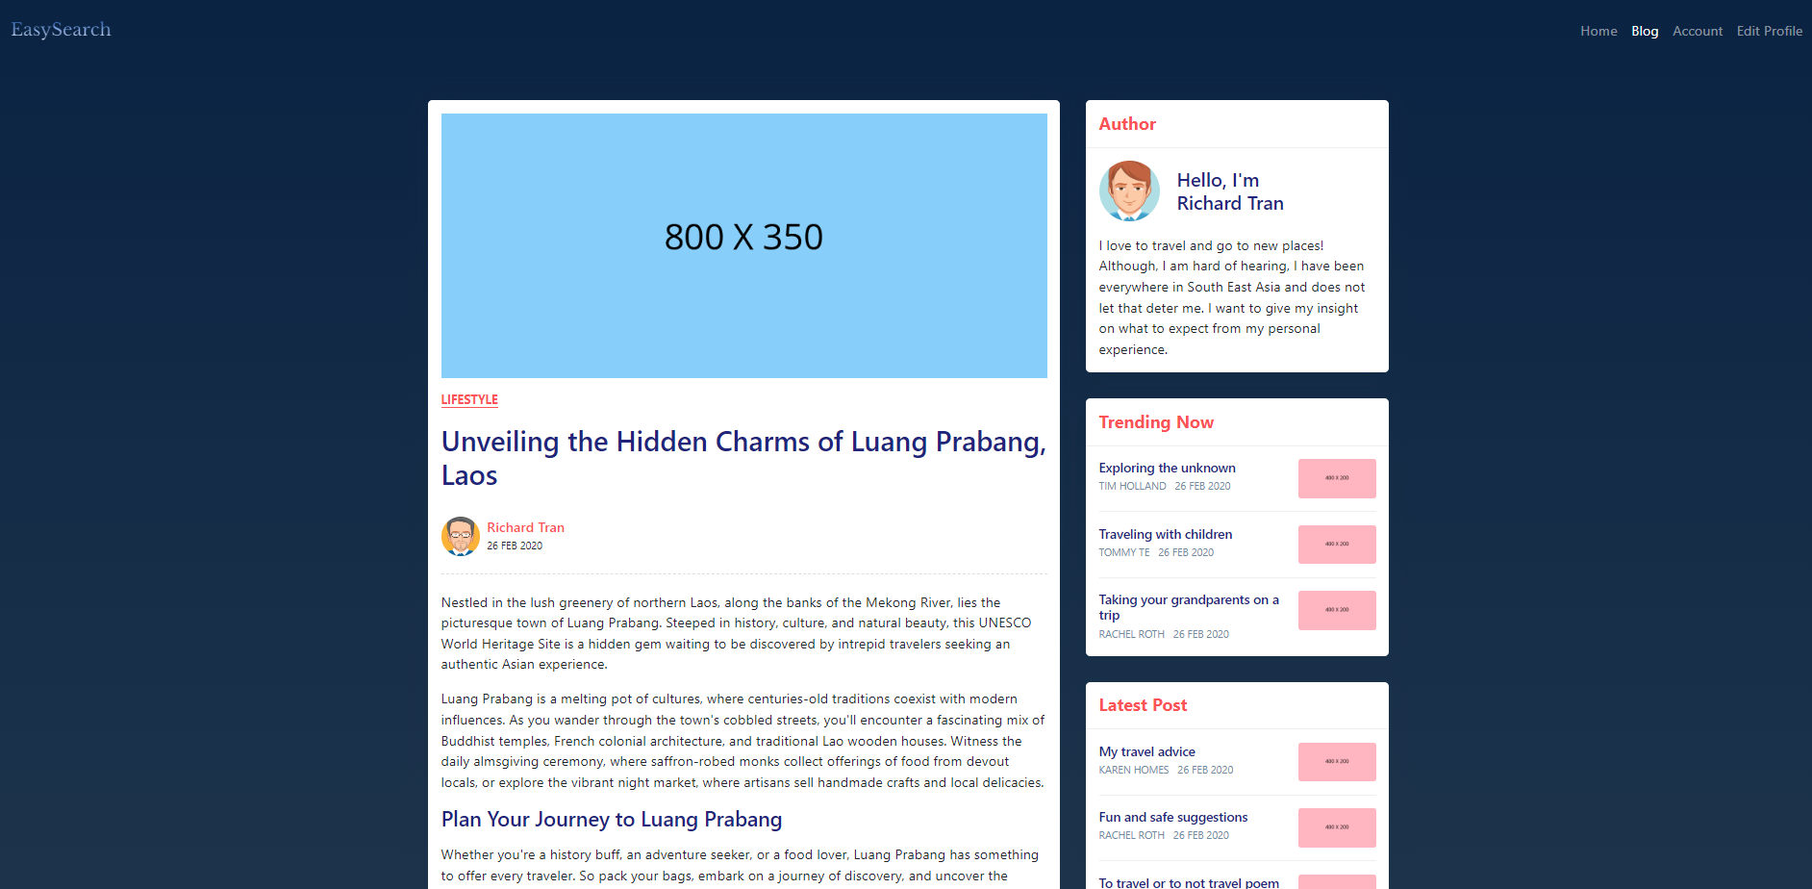
Minimum Viable Product – Blog Post -1

Slide 28
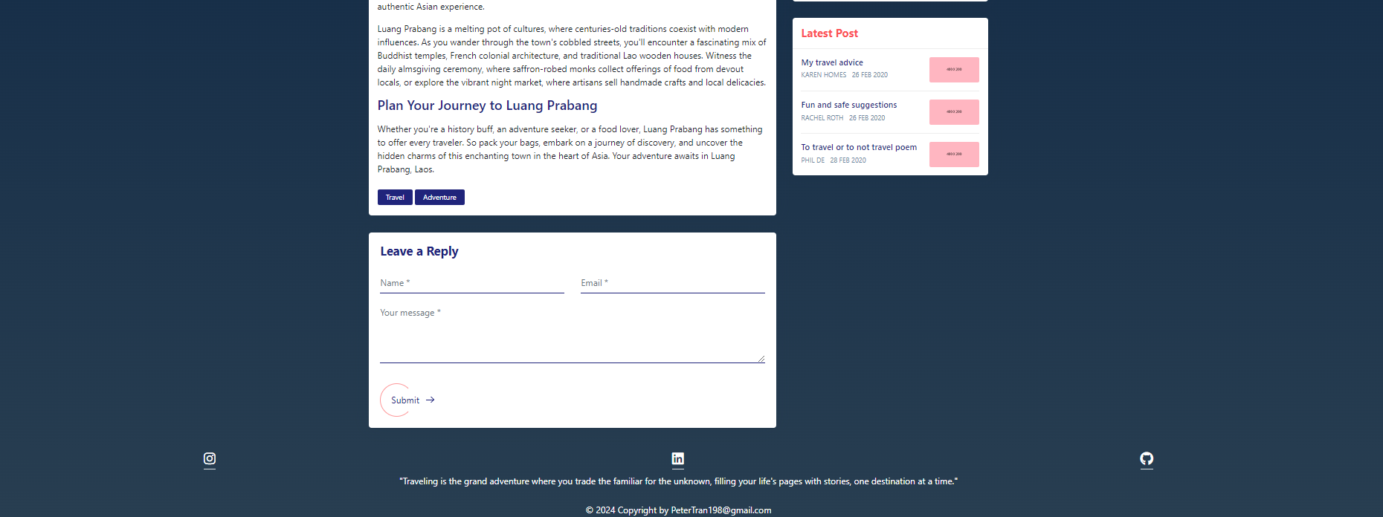
Minimum Viable Product – Blog Post -2

Slide 29
References
Behance. "Travel UX/UI Case Study." Behance, www.behance.net/gallery/113994573/Travel-UX-UI-Case-Study.
Looti, Mohammad. “Keirsey Temperament Sorter in Psychology.” PSYCHOLOGICAL SCALES, 30 Aug. 2023, scales.arabpsychology.com/2022/11/19/keirsey-temperament-sorter/.
"Social Media Marketing: What It Is and How to Build Your Strategy." Sprout Social, 28 Feb. 2024, sproutsocial.com/insights/social-media-marketing-strategy/.

